Slide 1
Pricing long term care insurance contracts Upper Triangular (UT) model
傅鈺婷
指導教授：戴天時 教授
論文作者：B. Levikson, G. Mizrahi

Slide 2
Upper Triangular (UT) model
absorbing Markov chain
A
B
absorbing state
C

Slide 3
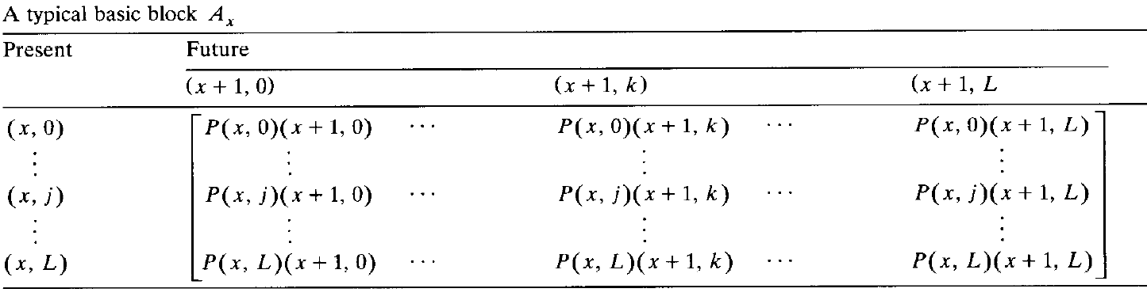
Upper Triangular (UT) model
typical basic block

Slide 4
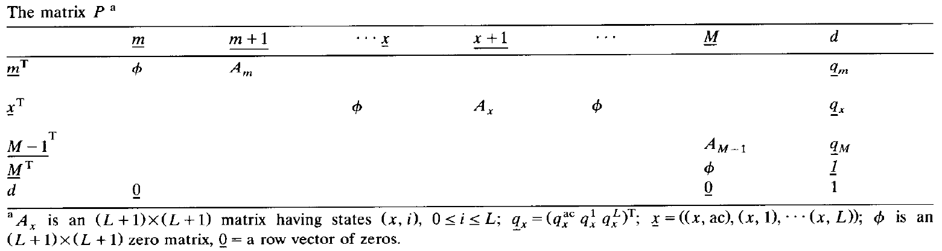
Upper Triangular (UT) model

Slide 5
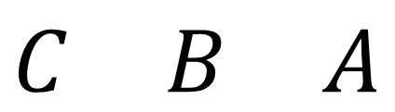
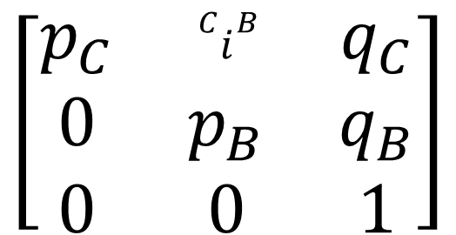

Upper Triangular (UT) model
typical basic block
死亡
A
B
長照需求
absorbing state
下一期
$$\begin{matrix}C & B & A\end{matrix}$$
$$\begin{matrix}C \\ B \\ A\end{matrix}$$
$$\left[\begin{matrix}p_{C} & {}_{}^{C}{i_{}^{B}} & q_{C} \\ 0 & p_{B} & q_{B} \\ 0 & 0 & 1\end{matrix}\right]$$
C
本期
有活動力

Slide 6
Upper Triangular (UT) model
typical basic block

Slide 7
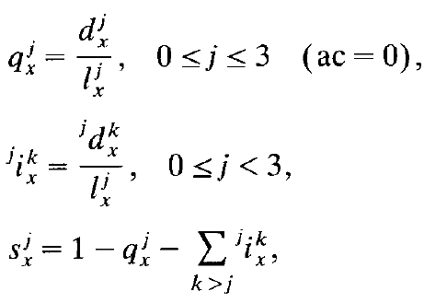
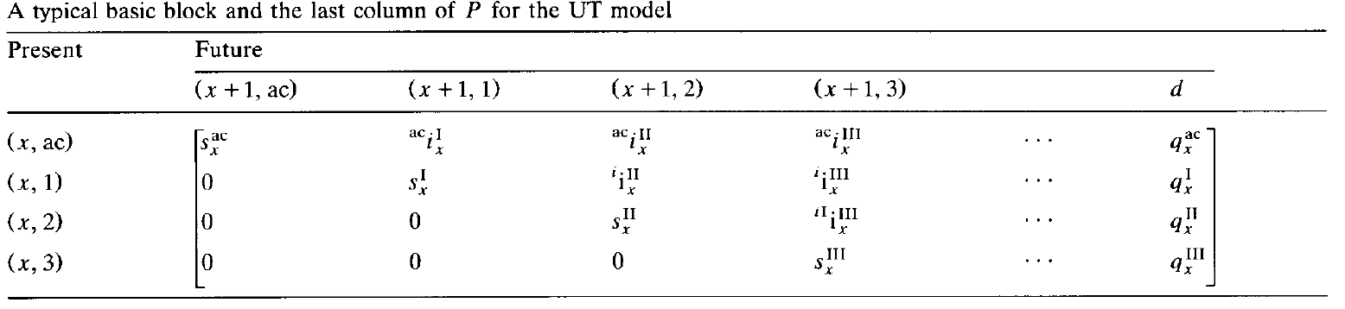
Upper Triangular (UT) model
以照護等級分成3等級為例

Slide 8
Upper Triangular (UT) model

Slide 9




資料實際使用
活動力下以及長期照護下的各年齡層死亡人數
活動力下轉長照需求的人數(長照等級人口間轉換人數)
t
x
x+1
生存
長照人口
$$N_{x}$$
$$N_{x}(1−q_{x}^{I})$$
$$N_{x+1}$$
死亡
差距為新的長照人口，也就是說活動力轉長照需求人口
$$N_{x}×q_{x}^{I}$$

Slide 10
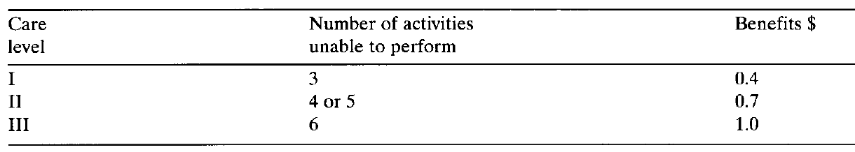
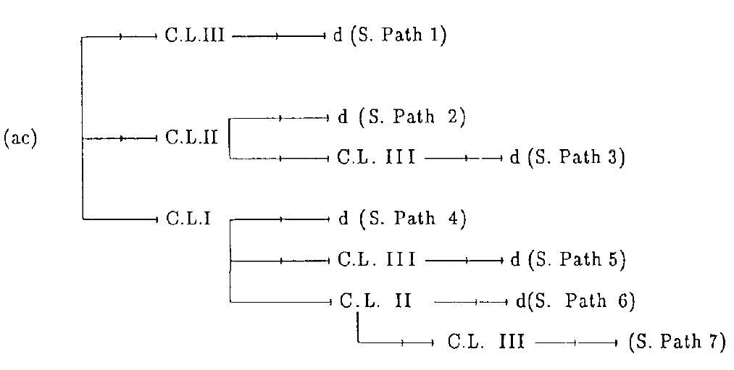
Discounted Value of Future Benefits

Slide 11
Discounted Value of Future Benefits

Slide 12
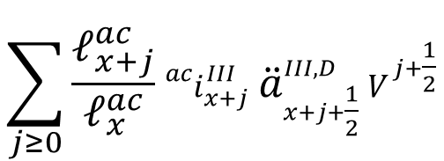
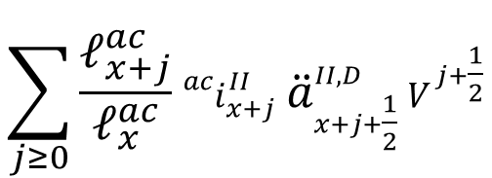
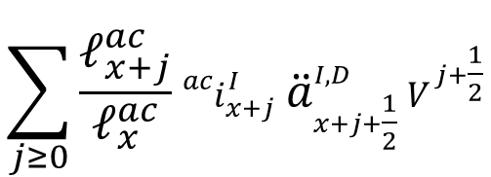
Discounted Value of Future Benefits
$$\sum_{j≥0}{\frac{ℓ_{x+j}^{ac}}{ℓ_{x}^{ac}}}{}_{}^{ac}{i_{x+j}^{I}} {\ddot{a}}_{x+j+\frac{1}{2}}^{I,D} V^{j+\frac{1}{2}}$$
ac
I
$$\sum_{j≥0}{\frac{ℓ_{x+j}^{ac}}{ℓ_{x}^{ac}}}{}_{}^{ac}{i_{x+j}^{II}} {\ddot{a}}_{x+j+\frac{1}{2}}^{II,D} V^{j+\frac{1}{2}}$$
II
$$\sum_{j≥0}{\frac{ℓ_{x+j}^{ac}}{ℓ_{x}^{ac}}}{}_{}^{ac}{i_{x+j}^{III}} {\ddot{a}}_{x+j+\frac{1}{2}}^{III,D} V^{j+\frac{1}{2}}$$
III

Slide 13
Discounted Value of Future Benefits

Slide 14


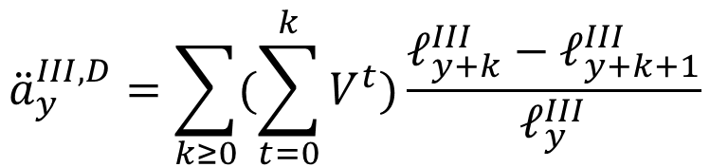


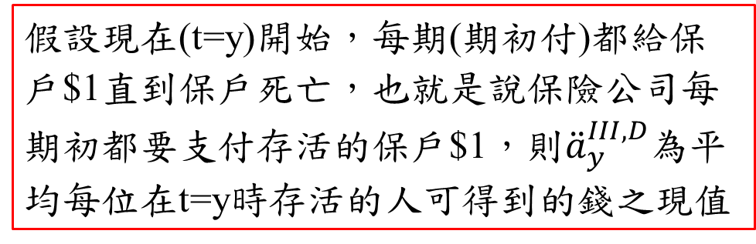
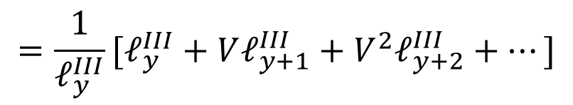

Discounted Value of Future Benefits
$${\ddot{a}}_{y}^{III,D}=\sum_{k≥0}{(\sum_{t=0}^{k}{V^{t}})\frac{ℓ_{y+k}^{III}−ℓ_{y+k+1}^{III}}{ℓ_{y}^{III}}}$$
$$=\frac{1}{ℓ_{y}^{III}}[\left(ℓ_{y}^{III}−ℓ_{y+1}^{III}\right)+\left(1+V\right)\left(ℓ_{y+1}^{III}−ℓ_{y+2}^{III}\right)+\left(1+V+V^{2}\right)\left(ℓ_{y+2}^{III}−ℓ_{y+3}^{III}\right)+⋯]$$
$$=\frac{1}{ℓ_{y}^{III}}[ℓ_{y}^{III}+Vℓ_{y+1}^{III}+V^{2}ℓ_{y+2}^{III}+⋯]$$
假設現在(t=y)開始，每期(期初付)都給保戶$1直到保戶死亡，也就是說保險公司每期初都要支付存活的保戶$1，則${\ddot{a}}_{y}^{III,D}$為平均每位在t=y時存活的人可得到的錢之現值
y
y+1
y+2
$$⋯$$
$$⋯$$
$$ℓ_{y}^{III}$$
$$ℓ_{y+1}^{III}$$
$$ℓ_{y+2}^{III}$$

Slide 15
Discounted Value of Future Benefits

Slide 16
Discounted Value of Future Benefits

Slide 17
Discounted Value of Future Benefits

Slide 18

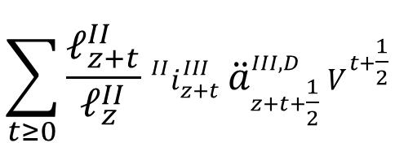

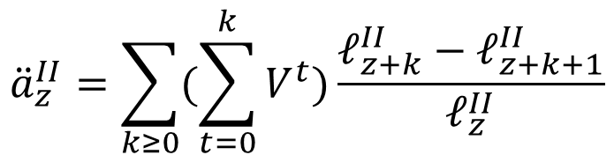



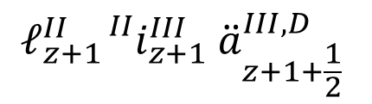

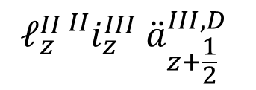
Discounted Value of Future Benefits
$${\ddot{a}}_{z}^{II}=\sum_{k≥0}{(\sum_{t=0}^{k}{V^{t}})\frac{ℓ_{z+k}^{II}−ℓ_{z+k+1}^{II}}{ℓ_{z}^{II}}}$$
II
d
$$\sum_{t≥0}{\frac{ℓ_{z+t}^{II}}{ℓ_{z}^{II}}}{}_{}^{II}{i_{z+t}^{III}} {\ddot{a}}_{z+t+\frac{1}{2}}^{III,D} V^{t+\frac{1}{2}}$$
III
d
y+1/2
y+1+1/2
$$⋯$$
y
y+1
y+2
$$ℓ_{z}^{II}$$
$$ℓ_{z+1}^{II}$$
$$ℓ_{z+2}^{II}$$
$$⋯$$
$$ℓ_{z}^{II}{}_{}^{II}{i_{z}^{III}} {\ddot{a}}_{z+\frac{1}{2}}^{III,D}$$
$$ℓ_{z+1}^{II}{}_{}^{II}{i_{z+1}^{III}} {\ddot{a}}_{z+1+\frac{1}{2}}^{III,D}$$
$$⋯$$

Slide 19
Discounted Value of Future Benefits

Slide 20

Discounted Value of Future Benefits
$${\ddot{a}}_{z}^{II}=\sum_{k≥0}{(\sum_{t=0}^{k}{V^{t}})\frac{ℓ_{z+k}^{II}−ℓ_{z+k+1}^{II}}{ℓ_{z}^{II}}}$$
$$×0.7$$
II
d
$$\sum_{t≥0}{\frac{ℓ_{z+t}^{II}}{ℓ_{z}^{II}}}{}_{}^{II}{i_{z+t}^{III}} {\ddot{a}}_{z+t+\frac{1}{2}}^{III,D} V^{t+\frac{1}{2}}$$
III
d
y+1/2
y+1+1/2
$$⋯$$
y
y+1
y+2
$$ℓ_{z}^{II}$$
$$ℓ_{z+1}^{II}$$
$$ℓ_{z+2}^{II}$$
$$⋯$$
$$ℓ_{z}^{II}{}_{}^{II}{i_{z}^{III}} {\ddot{a}}_{z+\frac{1}{2}}^{III,D}$$
$$ℓ_{z+1}^{II}{}_{}^{II}{i_{z+1}^{III}} {\ddot{a}}_{z+1+\frac{1}{2}}^{III,D}$$
$$⋯$$

Slide 21
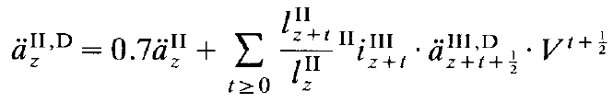
Discounted Value of Future Benefits
$${\ddot{a}}_{z}^{II}=\sum_{k≥0}{(\sum_{t=0}^{k}{V^{t}})\frac{ℓ_{z+k}^{II}−ℓ_{z+k+1}^{II}}{ℓ_{z}^{II}}}$$
$$×0.7$$
II
d
$$\sum_{t≥0}{\frac{ℓ_{z+t}^{II}}{ℓ_{z}^{II}}}{}_{}^{II}{i_{z+t}^{III}} {\ddot{a}}_{z+t+\frac{1}{2}}^{III,D} V^{t+\frac{1}{2}}$$
III
d

Slide 22
Discounted Value of Future Benefits

Slide 23
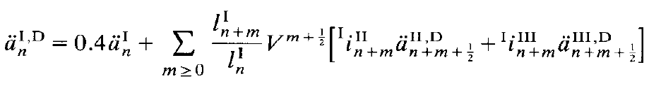
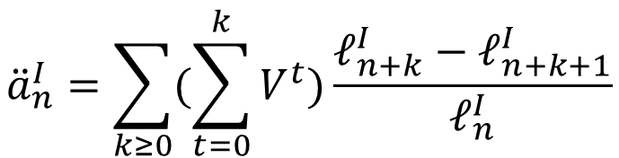

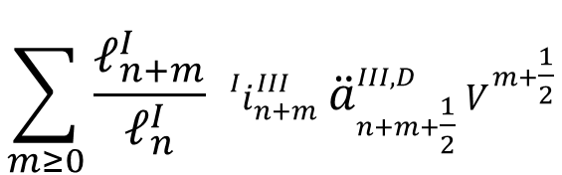
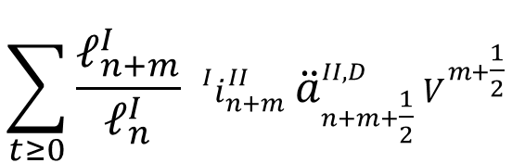
Discounted Value of Future Benefits
$${\ddot{a}}_{n}^{I}=\sum_{k≥0}{(\sum_{t=0}^{k}{V^{t}})\frac{ℓ_{n+k}^{I}−ℓ_{n+k+1}^{I}}{ℓ_{n}^{I}}}$$
$$×0.4$$
I
d
$$\sum_{t≥0}{\frac{ℓ_{n+m}^{I}}{ℓ_{n}^{I}}}{}_{}^{I}{i_{n+m}^{II}} {\ddot{a}}_{n+m+\frac{1}{2}}^{II,D} V^{m+\frac{1}{2}}$$
II
d
$$\sum_{m≥0}{\frac{ℓ_{n+m}^{I}}{ℓ_{n}^{I}}}{}_{}^{I}{i_{n+m}^{III}} {\ddot{a}}_{n+m+\frac{1}{2}}^{III,D} V^{m+\frac{1}{2}}$$
III
d

